Slide 1
Content
KNN Introduction & Working
K Nearest Neighbours (KNN) Introduction
Working of KNN Algorithm
Distance Measures –
Euclidian
Manhattan
Minkowski
KNN Classifiers
Questions!
Amardeep Chauhan
23th April, 2022

Slide 2
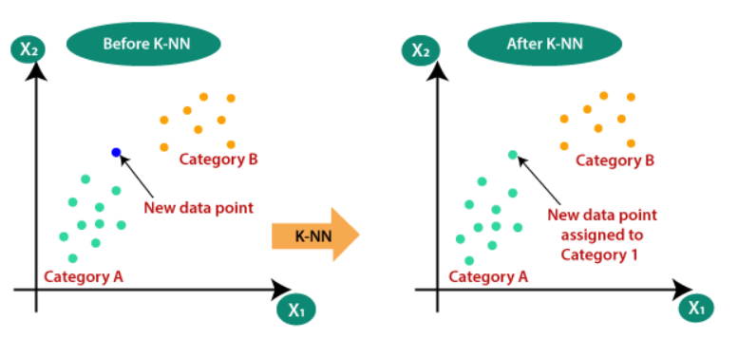
K-Nearest Neighbours (KNN) Introduction
KNN is a supervised classification and regression algorithm. [COND]
It is one of those algorithms which are simple, easily interpretable, and are capable of producing reliable results.
It is non-parametric in nature and follows a lazy learning process.
Source

Slide 3
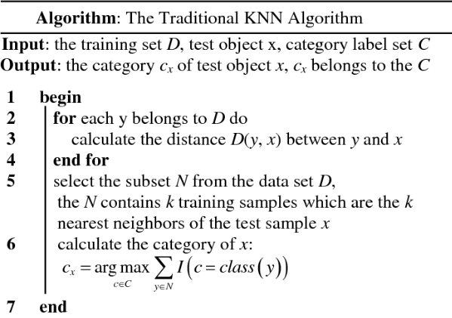
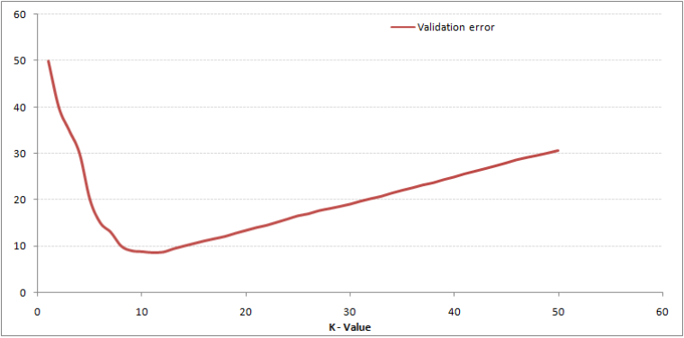
Working of KNN Algorithm
Load the training and testing datasets.
Specify or choose the value of K.
For each point on the test data perform the following:
Calculate the distance between the point and each point of the training dataset. We can use Euclidean distance or Manhattan distance.
Sort the values in ascending order based on distances.
Find the top K values from the sorted list.
Find the frequency (Mode) of the labels of the top K values.
Assign the mode to the test data point.
The assigned value is the classified or predicted value for the particular test data point.
Source
Best value of K!
Small value of K can result in underfitting.
High value of K can result in overfitting.
Elbow method or a cross-validation technique should be used to find the most optimal value of K.

Slide 4
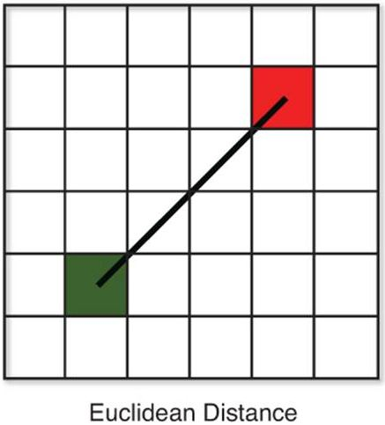
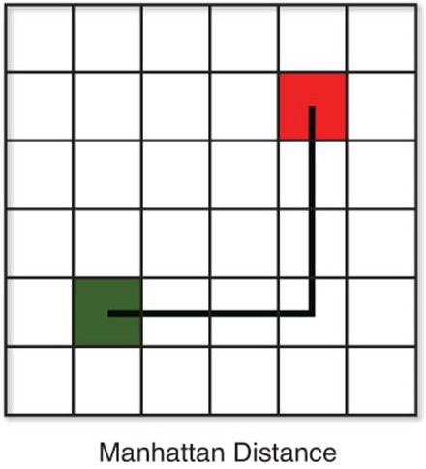
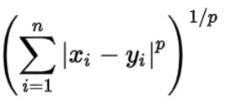
Distance Measures Euclidian, Manhattan, and Minkowski
Euclidean Distance: Euclidean distance is calculated as the square root of the sum of the squared differences between a new point (x) and an existing point (y).
Manhattan Distance: The distance between two points is the sum of the absolute differences of their Cartesian coordinates. Also known as taxi distance and cab distance.
Hamming Distance: It is used for categorical variables. If the value (x) and the value (y) are the same, the distance D will be equal to 0 . Otherwise D=1.
Minkowski Distance – It is a metric intended for real-valued vector spaces. We can calculate Minkowski distance only in a normed vector space, which means in a space where distances can be represented as a vector that has a length and the lengths cannot be negative.
Conditions
Non-negativity: d(x, y) >= 0
Identity: d(x, y) = 0 if and only if x == y
Symmetry: d(x, y) = d(y, x)
Triangle Inequality: d(x, y) + d(y, z) >= d(x, z)
This above formula for Minkowski distance is in generalized form and we can manipulate it to get different distance metrices.
The p value in the formula can be manipulated to give us different distances like:
p = 1, when p is set to 1 we get Manhattan distance
p = 2, when p is set to 2 we get Euclidean distance
Source

Slide 5

KNN Classifiers
Intuition:
KNN classifier finds a group of ‘k’ objects in the training set that are closest to the test object, and bases the assignment of a label on the predominance of a particular class in this neighborhood.
There are three key elements of this approach:
Labeled historical data
Distance or similarity metric to compute distance between datapoints
The value of k, to apply during majority voting for a test (unlabeled) datapoint.
In short, to classify an unlabeled object (test), the distance of this object to the labeled objects (train) is computed, its k-nearest neighbors are identified, and the [majority] class labels of these nearest neighbors are then used to determine the class label of the object.
Majority Voting: y_{pred} = argmax _{v} $\sum_{\left(xi, yi\right)}^{Dk}{I (v=yi)}$
where,
y_{pred} = Predicted class label,
v = Class label (under iteration),
D_{k} = K-nearest neighbor datapoints (subset of overall training data),
y_{i} = Class label for the i^{th} nearest neighbors,
I(·) = Indicator function that returns the value 1 if its argument is true and 0 otherwise.

Slide 6
Questions!!

